Slide 1


Geometric Analysis Based Algorithms for Effective Representation and Detection of Curves with Application to Tracking Moving Dim Target
Advisor: Dr. Ofer Levi
By: Galit Volpert

Slide 2
Presentation Outline
Motivation
Objectives
Background
SHAS vs other X-ray approaches
Dynamic SHAS
Dim Target tracking application
Experiments Design
Results

Slide 3
Motivation
Geometric Analysis
Detect, organize, represent, and manipulate
data which nominally span a high-dimensional space but which contain important features which are approximately concentrated on lower-dimensional subsets (curves, sheets, etc.).
http://www.ipam.ucla.edu/programs/long-programs/multiscale-geometry-and-analysis-in-high-dimensions/
Notes:
Scientific area that deals with…..

Slide 4
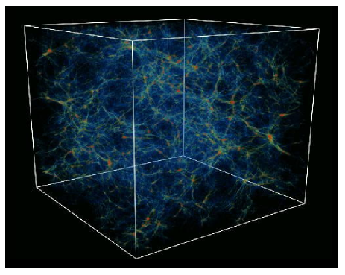
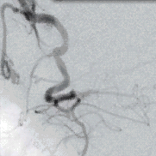
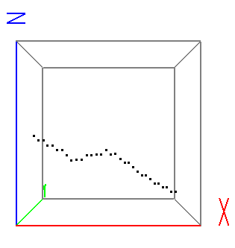
Motivation
Data of Interest
n³ – voxels (cube), f(x,y,z)
-point field
Contains filaments and noise
Notes:
Features in 3D

Slide 5
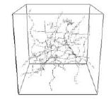
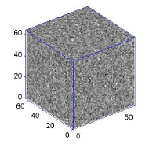
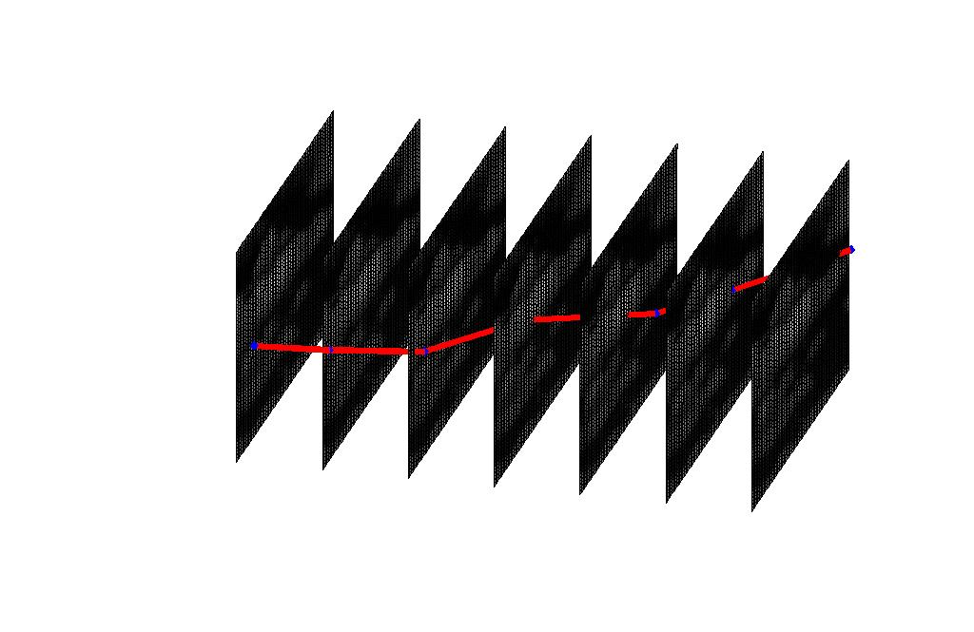

Data of Interest
3D
Foreground: Faint Filamentary Structures
Background: Noise (low SNR)
Medical and Biological Imaging
Astronomy (analysis of galaxy distribution)
Military object detection and tracking
Computer Vision

Slide 6
Motivation
Applications
Medical and Biological Imaging
Astronomy
Dim Objects Detection and Tracking

Slide 7
Objective
Validate the SHAS a Geometric approach algorithm, accuracy and efficiency by comparing to other discrete X-Ray transform algorithms such as Fast Slant Stack and Two-Scale Recursion.
Present the Dynamic SHAS as a computationally efficient algorithm for dynamically computing X-Ray coefficients inside a sliding window.
Develop a Dynamic SHAS based tool for tracking a dim target.

Slide 8
Background
The 2D X-Ray (Radon) Transform
As
Notes:
Scientific area that deals with…..

Slide 9
Background
The 3D X-Ray Transform
As
Notes:
Scientific area that deals with…..

Slide 10
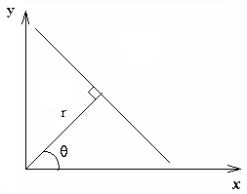
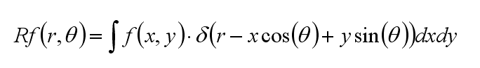
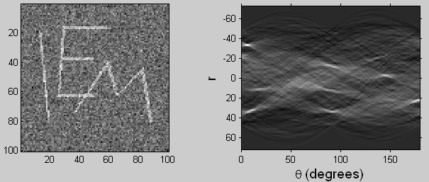
Scientific Background. The 2D X-Ray (Radon) Transform

Slide 11
Scientific Background. The 3D X-Ray Transform
Where L is a line in R³,
p is a variable indexing point on the line

Slide 12
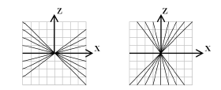
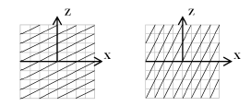
(Background) From Continuous to Discrete. Choice of Discrete Parameterization of Line Segments
Slope-Intercept System
Fixed intercept, varying slope
Fixed slope, varying intercept
X-driven
Z-driven
Notes:
Another aspect is choosing expressive set and parameterization of line segments for line integration

Slide 13
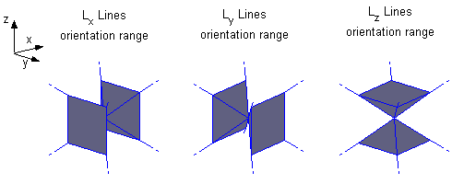
(Background) The 3D X-Ray Transform In Slope Intercept System

Slide 14
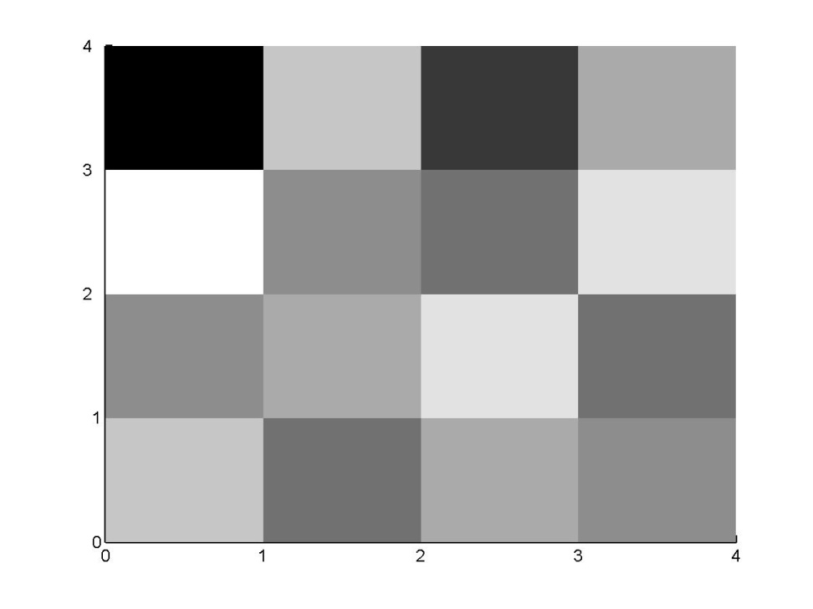
(Background) Computation of the Discrete X-ray Transform. Direct Evaluation Methods
0
9
1
9
10
5
3
10
6
8
10
3
9
3
8
4
Notes:
The most simple straightforward way for transform calculation
Weighted sum
Easy to understand but complicated

Slide 15
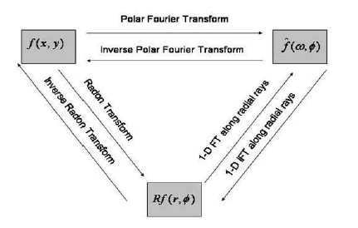
(Background) Computation of the Discrete X-ray Transform. Fourier-Domain Based Methods
Projection-Slice Theorem
Equivalent to computing integrals over trigonometric interpolation of the sampled image. Tied to slope-intercept system.
Computational Complexity – O(log(N)) per coefficient
Fast Slant Stack (2003), Averbuch et. al.
Notes:
The most simple straightforward way for transform calculation
Weighted sum
Easy to understand but complicated

Slide 16
Background
The 3D X-Ray Transform
As
Notes:
Scientific area that deals with…..

Slide 17
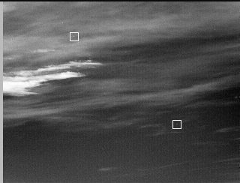
Background
Dim Target Detection
Infrared Images
Point Target
Noise, Background
Presumptions on Target Motion
In Space-Time Coordinates target trace can be seen as filament
Y
T
Notes:
Scientific area that deals with…..

Slide 18

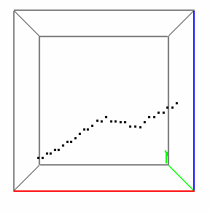
Multiframe Dim Target Detection (MFD)
Detection of man-made dim moving targets by imaging sensors and the estimation of their trajectories
A point target, which can affect up to four pixels in each frame
Low SNR (barely seen by naked eye)
A moving target leaves a signature in the 3D image
Acceleration does not exceed half a picture element per frame. Different kinds of background noise are considered.

Slide 19
Background
Bcvbcbv
Bcvbcv
Bcvbcb
Bcvcbvc
cbvbcb

Slide 20
(SHAS) Motivation: Desired X-Ray Transform Algorithm Performance Measures
Accuracy (with respect to Direct Evaluation and piecewise constant interpolation of digital image)
Speed
Memory access (Sequential/non-sequential )
Flexibility of line sets definition
Notes:
Our opinion about transform algorithm quality based on several measures

Slide 21
(Algorithm) SHAS Algorithm Properties
SHAS algorithm (“SHift And Sum”)
Exact
Fast
Memory-wise economical (Serial Access, “In-Place” calculations)
Flexible with respect to the choice if lines set (Suited for any equispaced lines family)
Easy for Implementation
Easy for Parallel Implementation
Notes:
The name of proposed algorithm is abbreviation of …
The qualities are …

Slide 22
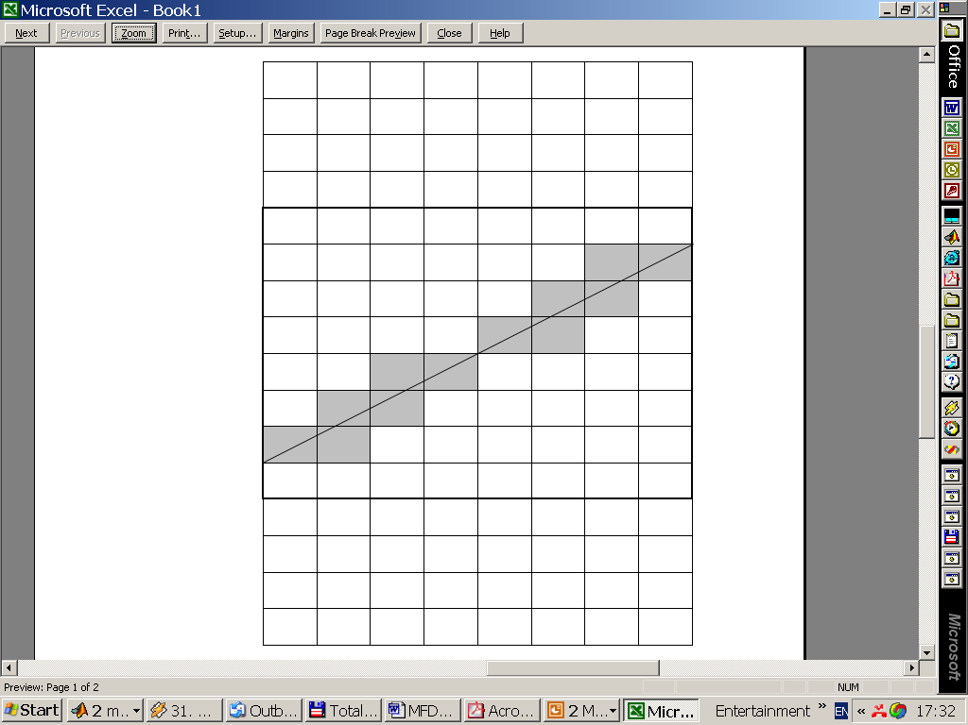
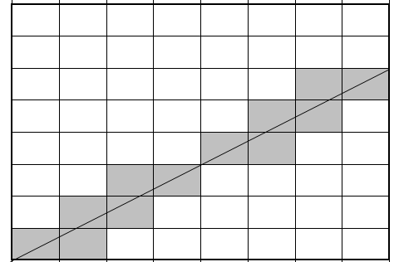
(Algorithm) Observation
Notes:
I’ll start by demonstrating the main ideas in 2D …
The distribution of weights for line integral is similar for parallel line segments up to appropriate shifts

Slide 23
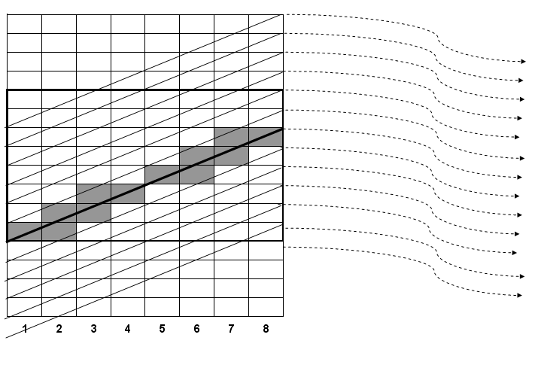
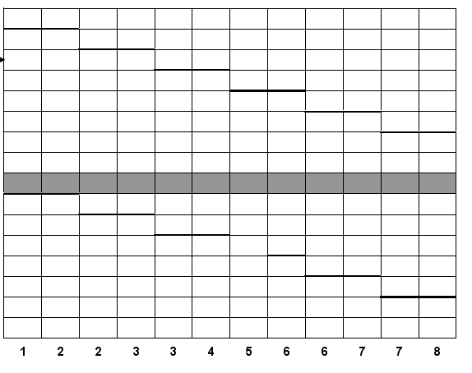
(Algorithm) Simultaneous calculation with serial memory access
Notes:
Note that weighted sum of all columns results in array of X-ray coefficients corresponding to parallel set of lines

Slide 24
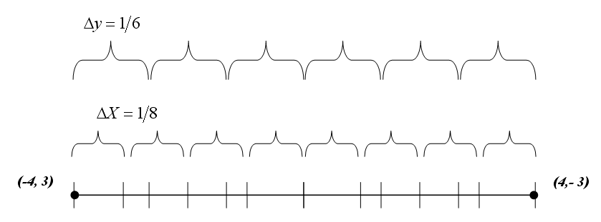
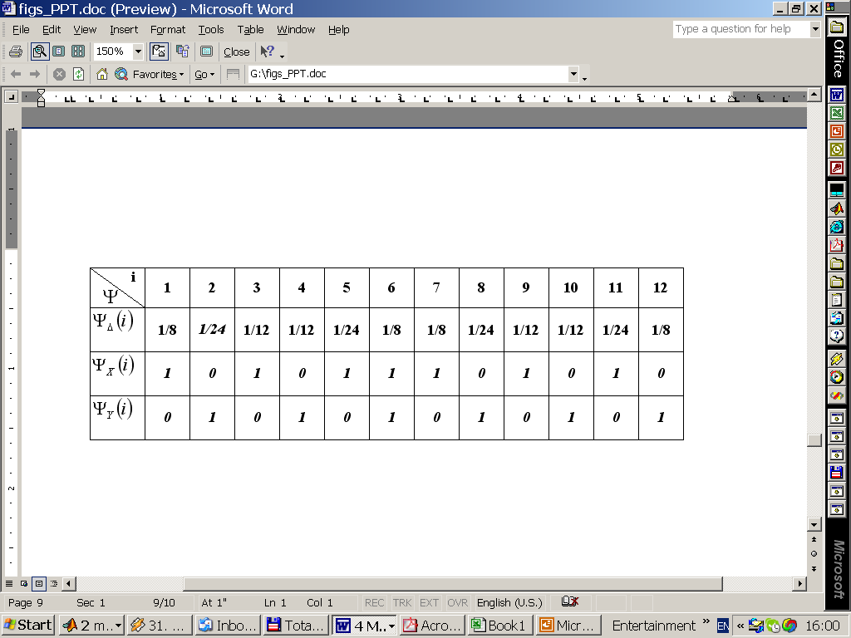
(Algorithm) Merging Series of Grid Intersections 2D
-8 -7 -6 -5 -4 -3 -2 -1 0 1 2 3 4 5 6 7 8
(-4,3)
(-3,3)
(-3,2)
(-2,2)
(-2,1)
. . .
-4 -3 -2 -1 0 1 2 3 4
Notes:
So this is the idea , now I will explain algorithm formally
First we calculate intersections of line segments with grid planes, we analyze intersections of line with zero intercept …
So we will know for each column if to make shift and weight to multiply

Slide 25
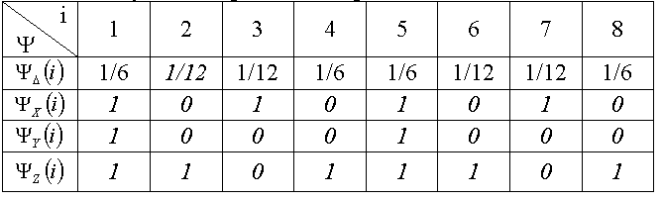
(Algorithm) Merging Series of Grid Intersections 3D
(-2,1,-3)
(2,-1, 3)
Notes:
The same idea in 3D

Slide 26
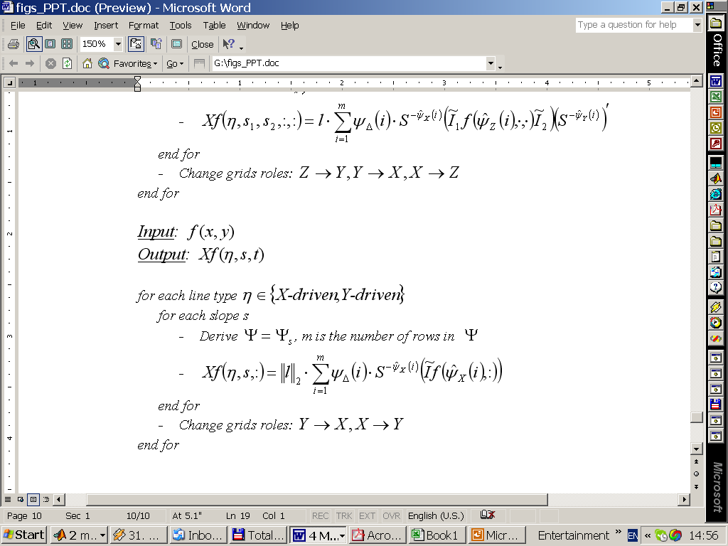
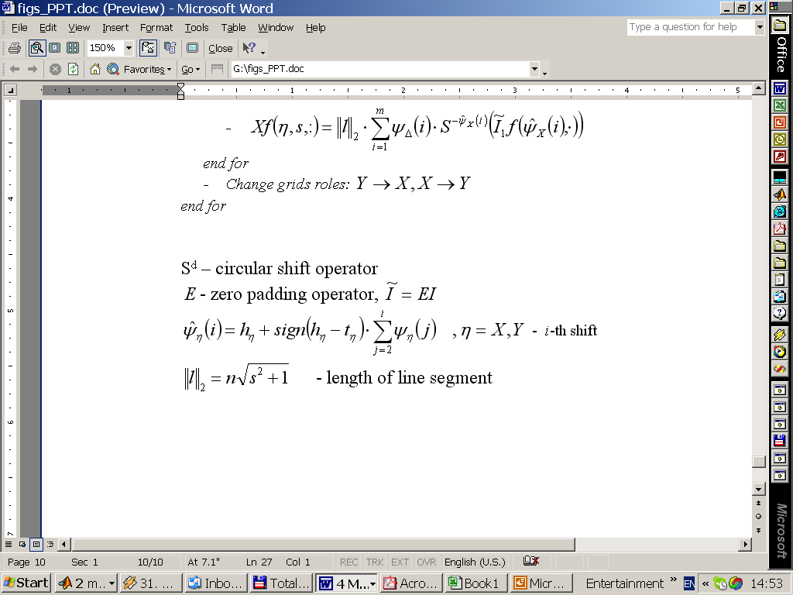
(Algorithm) SHAS Algorithm Pseudocode 2D
Notes:
The algebraic form of algorithm
Where …

Slide 27
(Performance) Speed
Pentium 4, 2.4GHz, 512Mb
C++ implementation of 3D transform
SHAS algorithm is faster for moderate sizes of input arrays
For Example:
Cube Side: 128
# Coefficients: 3.22E+09
Total Time: 5664 sec (~1.5 hour)
Per Coefficient: 1.76E-06 sec
Notes:
Theoretically O(log n) against O(n) , but in fact algorithm is comparative with FSS up to very high practical data cubes.
Due to serial access, simplicity.
Pentium III , 1Gb speed , 512 Mb RAM, 512 KB CASH

Slide 28
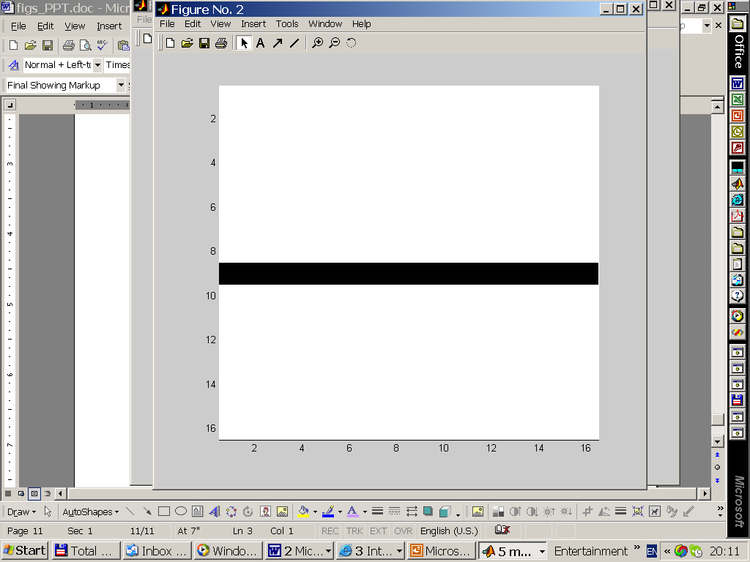
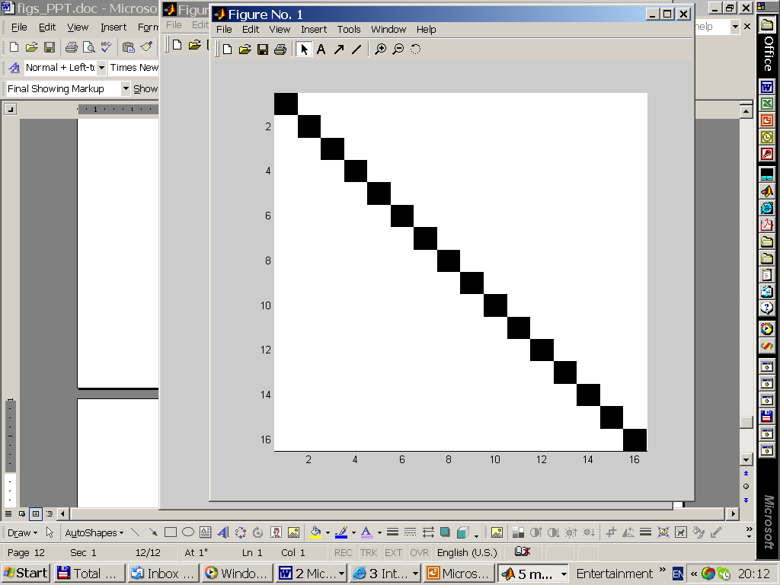
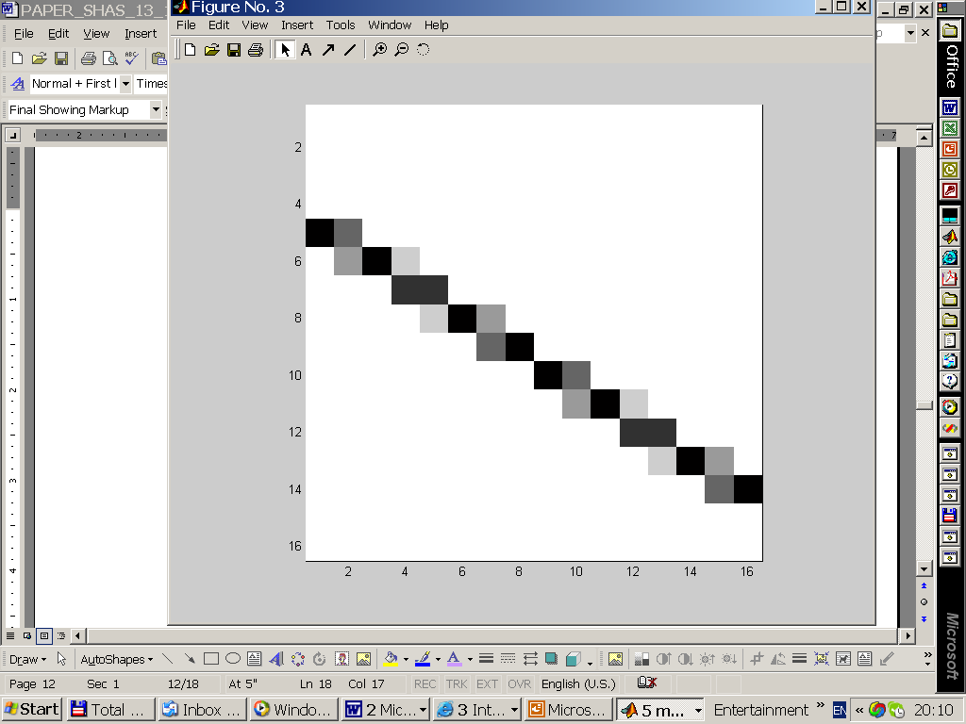
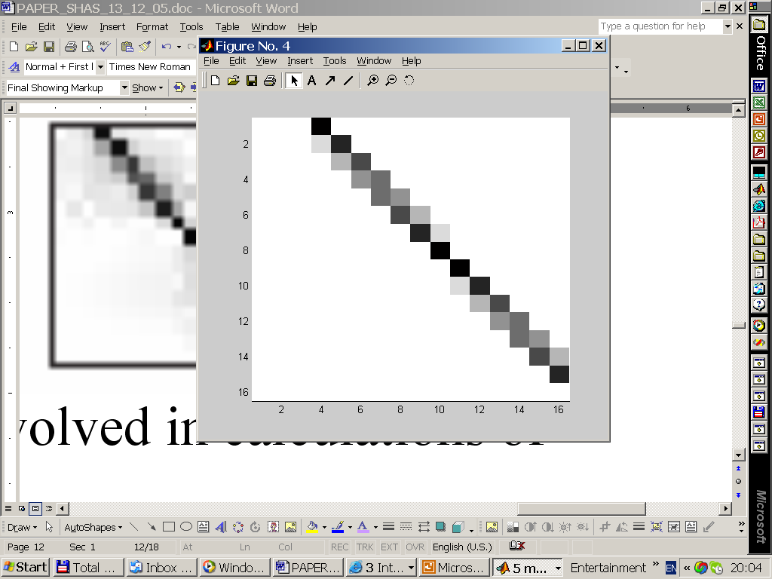
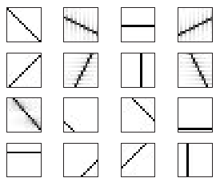

(Performance) Accuracy
Back Projection Of Various Coefficients
SHAS
Slant Stack

Slide 29
Dynamic SHAS Algorithm (DSHAS) Sliding Window Approach
Dynamic Region of Interest (RIO)
Real-Time Computations
Support: Axis-Parallel Window Transition (left/right/up/down/in/out)
Support: Shrink / Enlarge Window (limited)

Slide 30
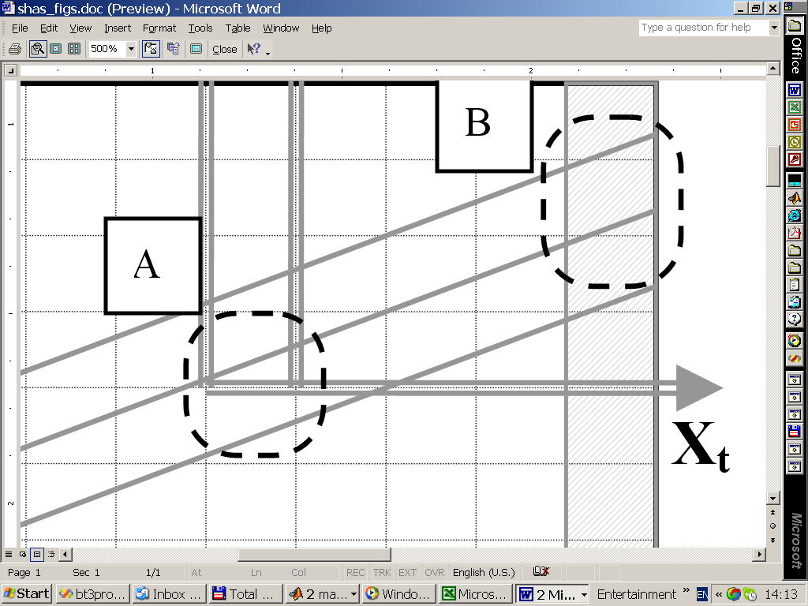
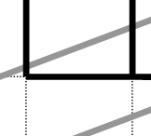
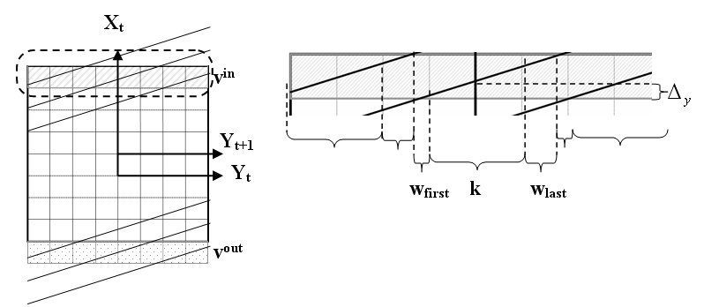
DSHAS
Y_{t}
Y_{t+1}
X-Driven Update
v^{out}
v^{in}
A
B
B
Y_{t}
Y_{t+1}
X_{t}
A
w₁
1-w₁
Y-Driven Update

Slide 31
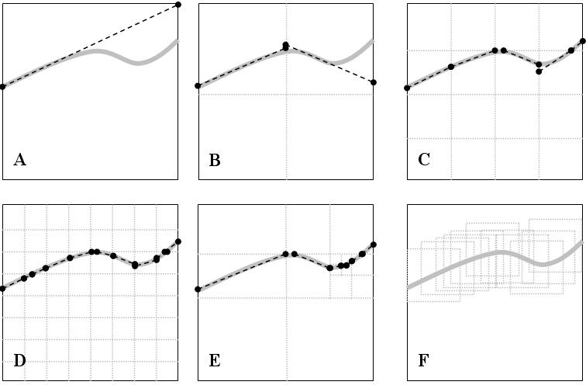
DSHAS: Why Sliding Window ?
Constraints on memory and speed (moderate cube 64³ => 1.5 Gb of coefficients)
Shift-invariant
Dynamic Region of Interest
Fast

Slide 32
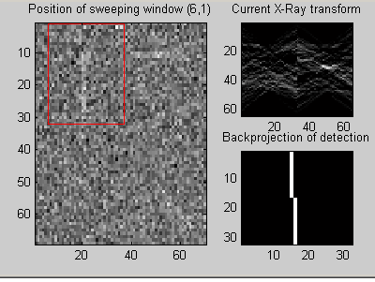
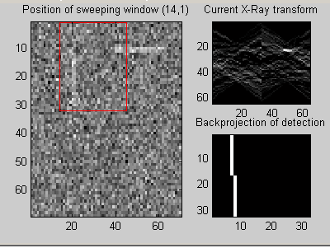
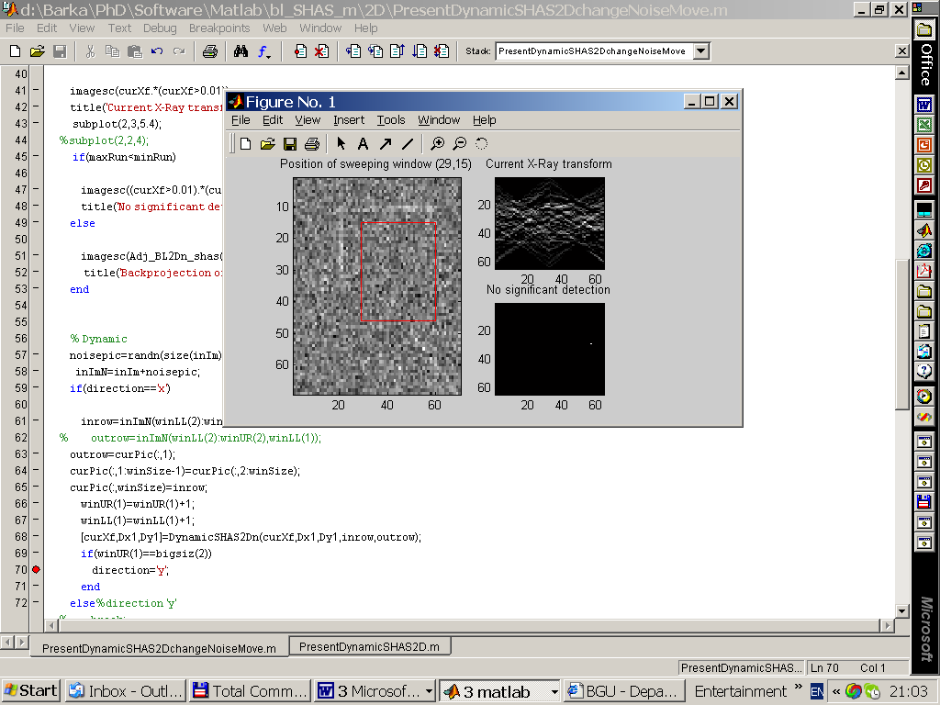
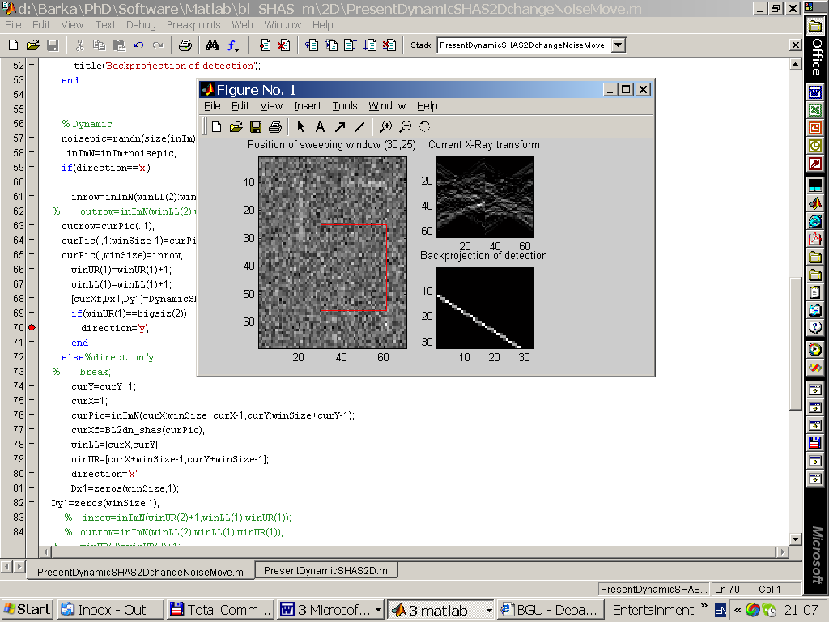
Dynamic SHAS Algorithm (DSHAS)
2D Application
3D Application (Related to MFD)
Natural Extension of SHAS algorithm
Optimal run-time (O(1) per coefficient)
Exact

